Slide 1
Mini Project Report|DBMS
(DBMS-I+DBMS-II)
Submitted by
Sujitha L
Darshan Jayantbhai Bhatt
Madabattula Jyothi
Mohini Pujari
Pranit Jadhav

Slide 2
AIM:
This is a mini project that explores a datasets of Sales & Delivery and restaurants by using SQL.
The “Sales and Delivery” dataset contains information about sales and delivery process including their Customer dimension, Market fact, order dimension, product dimension and shipping dimension.
They are often challenged for getting the customers details (i.e., valuable customer details, Days taken for delivery), earned profit, sales deliverable details and so on.
Another dataset called “Restaurant” contains information about various restaurants including their location, cuisine, ratings, and other relevant data.
They are also challenged for getting details of the total visits to all restaurants under all alcohol categories available, the average rating according to alcohol and price, the parking availability and so on.
We are going to use our due diligence to address all these challenges with help of DBMS aggregate functions, triggers, join function, window function.

Slide 3
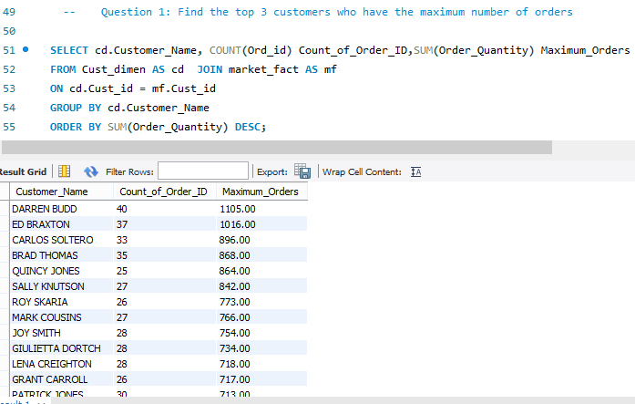
Part 1 – Sales and Delivery:
Explanation:
If we find the top 3 customers who have the maximum number of orders, it will help sales and delivery to identify the valuable customer.
Here we retrieved the customer name and count of order ID and maximum number of order quantity from two different tables cust_dimen & market_fact.
With help of join clause we found the exact matching records from these tables and following that we used group by functionality to aggregate all columns and also used order by to arrange the maximum number of orders.

Slide 4
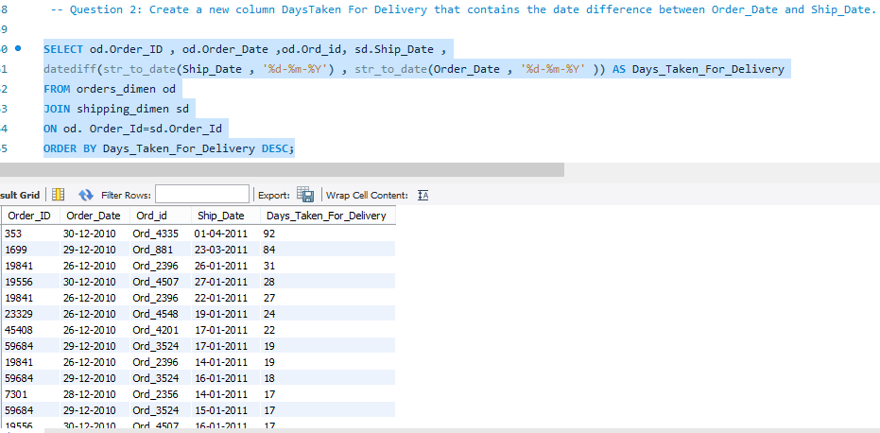
Question 2
Explanation:
We have created a new column called “Days Taken For Delivery” that contains the date difference between Order_Date and Ship_Date.
Here we retrieved the count of days for order delivery from the tables “orders_dimen” and “shipping_dimen ”.
We used inner join functionality to join the two tables with help of unique identifier “Order_id”.
After joining the table we used “DATEDIFF” function to get the difference between shipment date and order date i.e., Delivery date of an order.

Slide 5
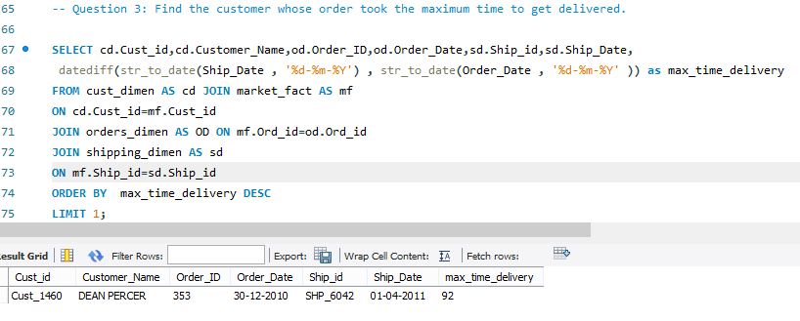
Question 3:
Explanation:
We have to identify the customer whose order took the maximum time to get delivered.
We retrieved the records from four different tables cust_dimen, market_fact, orders_dimen & shipping_dimen. We used inner join function to connect all the tables using common columns.
We used “datediff” function to get the order details which have taken more time for order delivery.
Finally We used “order by” and “LIMIT” function to get the highest values in descending order.

Slide 6
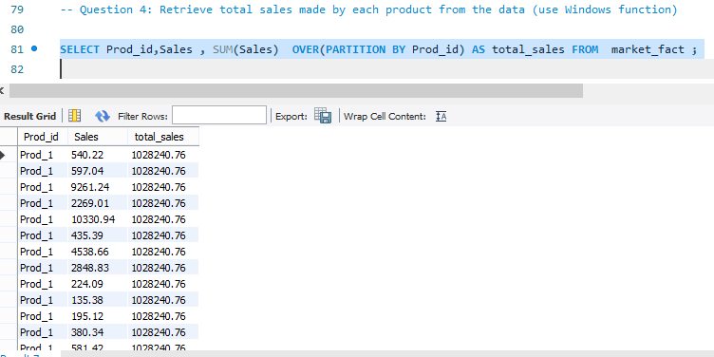
Question 4:
Explanation:
Here we are finding the sum of sales amount of each product which helps sales & delivery to focus on product deliverables. Also this will help sales & delivery to focus on improving the product which is having least sales amount.
We have retrieved total sales made by each product from the data by using Windows function.
We have retrieved the records from the table market_fact.
Hence we found total amount of each product with details i.e., Product ID, Sales & Sum of the sales amount.

Slide 7
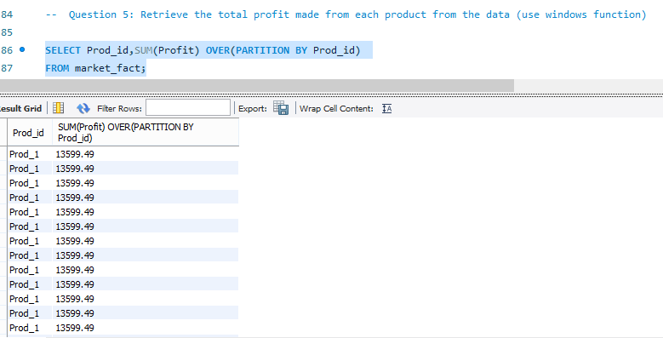
Question 5:
Explanation:
Here we are finding the sum of profit amount of each product which helps sales & delivery to focus on product deliverables. Also this will help sales & delivery to focus on improving the product which is having least profit amount.
We have retrieved total profit made by each product from the data by using Windows function.
We have retrieved the records from the table market_fact.
Hence we found total profit amount of each product with details i.e., Product Id & total profit.

Slide 8
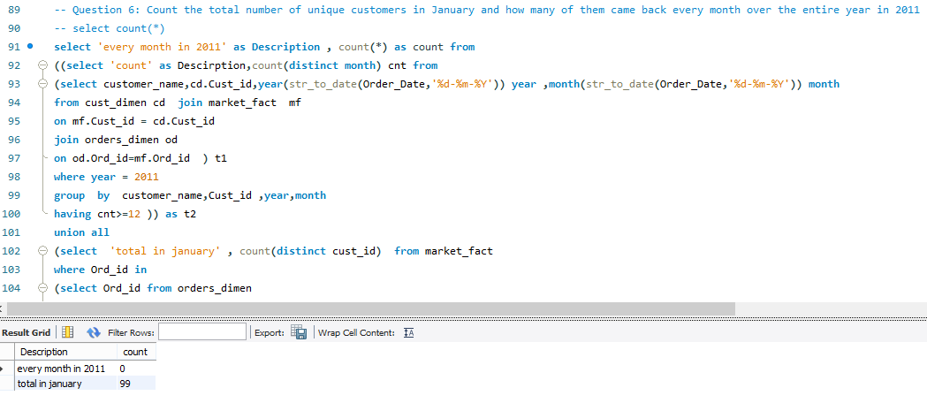
Question 6:
Explanation:
Here we used two sub queries along with one main query for getting count of customers who have came back every month over entire year in 2011 and then using union all operator to connect the another set of query for getting the unique customer details in January month.
As per the output we have noted that 99 unique customers who have visited in the month of January and none of them visited every month in 2011.

Slide 9
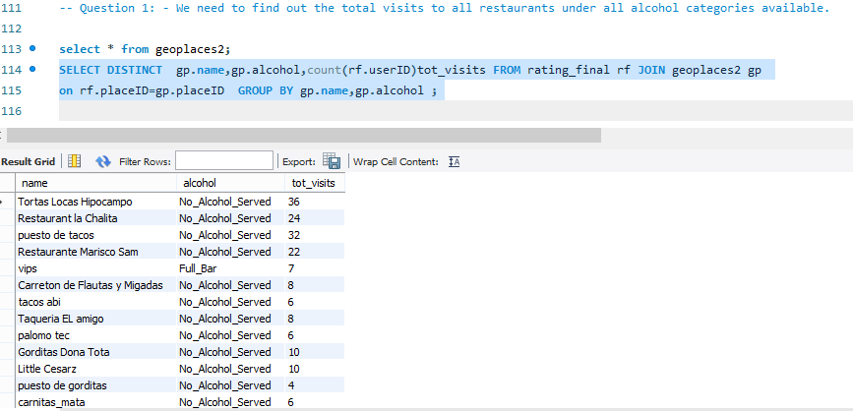
Part 2 – Restaurant
Explanation:
If we find the total visits to all restaurants under all alcohol categories available, it will help the restaurant to improve themselves.
We have to find out the total visits to all restaurants under all alcohol categories available.
We retrieved the records from rating_final and geoplaces2 tables. Using inner join function with “place_ID” as unique identifier and using count function to get the count of the total visits to all restaurants under all alcohol categories.
Using group by function to group the rows which have same values from name & alcohol columns.

Slide 10
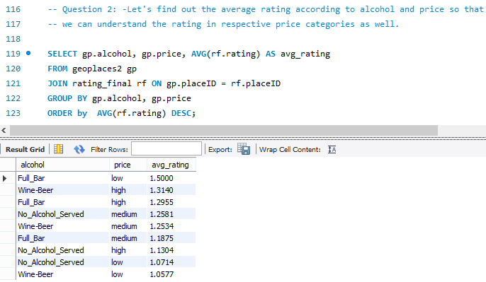
Question 2:
Explanation:
If we find the average rating according to alcohol and price, it will help restaurant to find the quality of service in affordable price to customers.
We have to find out the average rating according to alcohol and price . so that restaurant can rectify there prices according to alcohol served.
We have retrieved the records from the tables geoplaces2 & rating_final. Using the inner join function with “place_ID” as unique identifier i.e., by referring the columns alcohol, price to get the average rating of alcohol and price.
we have come to the conclusion that restaurant with low price and full bar have highest average rating and also if the price is high and alcohol is available rating is high . we have also seen rating decrease irrespective of price and alcohol . so there may be other factors affecting rating.

Slide 11
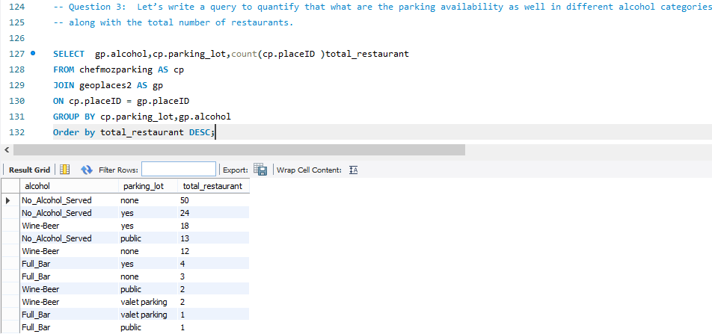
Question 3:
Explanation:
If we quantify the parking availability & different alcohol categories along with the total number of restaurants, it will help restaurant to help customer to visit their preferred restaurants.
We have to measure the quantity of parking availability and different alcohol categories along with the total number of restaurants.
We have retrieved the records form tables geoplaces2 and chefmozparking. Using inner join function with “place_ID” as unique identifier and using windows functions along with count function i.e., by referring the columns parking_lot, name (with their count) and alcohol to get the parking availability with different alcohol categories with respective to the total number of restaurants.

Slide 12
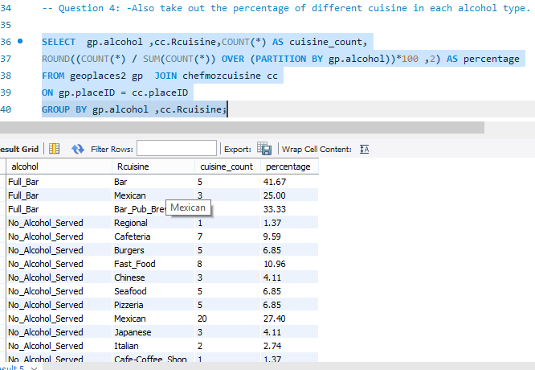
Question 4:
Explanation:
This query helps restaurant to have check on category of cuisines available in consideration of alcohol served.
We have to take out the percentage of different cuisine in each alcohol type.
We have retrieved the records from the tables geoplaces2 and chefmozcuisine using inner join function and windows function i.e., getting the percentage of each alcohol type from over all cuisine count.

Slide 13
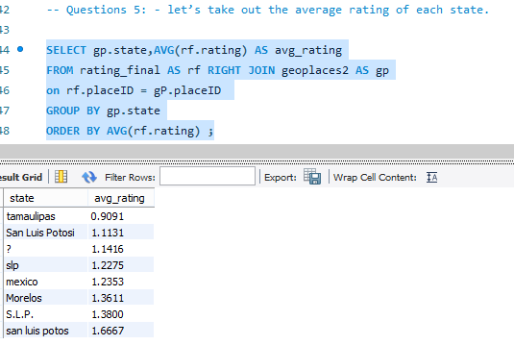
Questions 5:
Explanation:
This explains the average rating of restaurant in each state.
We have to take out the average rating of each state.
We have retrieved the records from the tables geoplaces2 and rating_final using the inner join function and average function for each state.

Slide 14
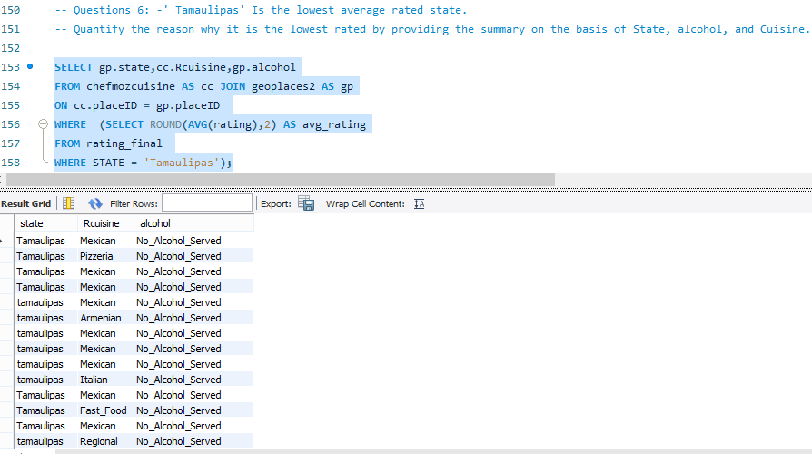
Questions 6:
Explanation:
We have used State, alcohol, and Cuisine, to come to the conclusion why Tamaulipas is lowest rated state.
We have retrieved the records from the tables chefmozcuisine & geoplaces2 using inner join function and average rating function.
As we can see “Tamaulipas” don’t serve alcohol this may a reason and also the less variety of cuisine availability .we have also noted that even highest rated restaurant in other state also don't serve alcohol . So cuisine taste can also be the reason.

Slide 15
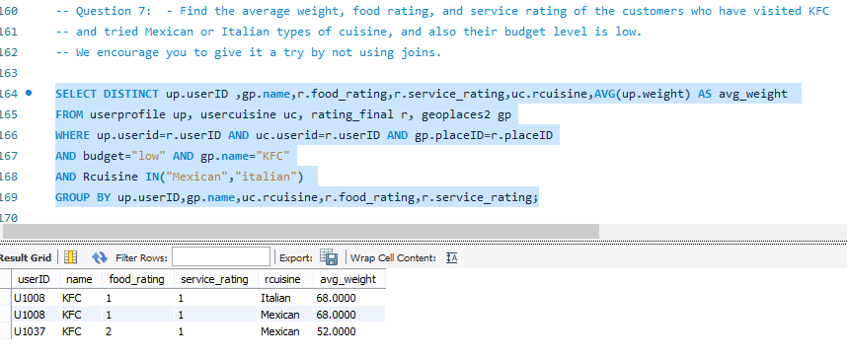
Question 7:
Explanation:
We have to find the average weight, food rating and service rating of the customers who have visited KFC.
We have retrieved the records from the tables userprofile, usercuisine, rating final, geoplaces2 using self join function i.e., using “where” clause tables are joined by itself without using join keyword. Also we used group by function to aggregate specified columns.
There are few ways to join table without using joins that is UNION and UNION ALL and WHERE clause . In our query we have used “WHERE clause”.

Slide 16
Part 3: Triggers
Question 1:
Create two called Student_details and Student_details_backup.
Table 1: Attributes
Student id, Student name, mail id, mobile no.
Table 2: Attribute
Student id, student name, mail id, mobile no.
You have the above two tables Students Details and Student Details Backup. Insert some records into Student details.
Problem:
Let’s say you are studying SQL for two weeks. In your institute, there is an employee who has been maintaining the student’s details -- and Student Details Backup tables. He / She is deleting the records from the Student details after the students completed the course -- and keeping the backup in the student details backup table by inserting the records every time. You are noticing this daily-- and now you want to help him/her by not inserting the records for backup purpose when he/she delete the records.-- write a trigger that should be capable enough to insert the student details in the backup table whenever the employee deletes records -- from the student details table.-- Note: Your query should insert the rows in the backup table before deleting the records from student details.

Slide 17
Answer:
CREATE DATABASE students;
USE students;
CREATE TABLE Students_Details(
Student_ID INTEGER NOT NULL PRIMARY KEY,
Student_Name VARCHAR(20),
Mail_ID VARCHAR(30),
MOBILE_NO VARCHAR(10));
CREATE TABLE Student_details_backup(
Student_ID INTEGER NOT NULL PRIMARY KEY,
Student_Name VARCHAR(20),
Mail_ID VARCHAR(30),
MOBILE_NO VARCHAR(10));

Slide 18
INSERT INTO Students_Details VALUES(1011,'Diya','diya1508@gmail.com','9254876398'),
(1012,'Sashini','sashini2022@gmail.com','9674536271'),
(1013,'Ahana','ahana2906@gmail.com','9567030304'),
(1014,'Bala','bala3109@gmail.com','9078653421'),
(1015,'Nivi','nivi2508@gmail.com','8976450910');
SELECT * FROM Students_Details;
CREATE TRIGGER trigger_backup
BEFORE DELETE
ON Students_Details FOR EACH ROW
INSERT INTO Student_details_backup(Student_ID,Student_Name,Mail_ID,MOBILE_NO)
VALUES(OLD.Student_ID,OLD.Student_Name,OLD.Mail_ID,OLD.MOBILE_NO);
DELETE FROM Students_Details
WHERE Student_ID=1011;
SELECT * FROM Student_details_backup;

Slide 19
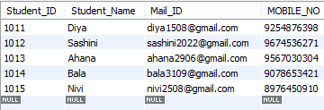
Explanation:
We have created the database called students . In this DB there are two tables created which are Students_Details & Student_details_backup.
Inserted five rows of record into students_Details table.
Created trigger function called trigger_backup. Before deleting the original records from main table “Students_Details”. We inserted all five records into Student_details_backup using the trigger function.

Slide 20
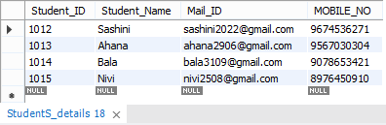
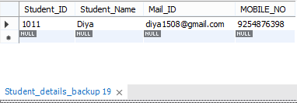
Initiate the trigger function by deleting the one records in main table “Student_Details”.
Immediately the particular record i.e., Student_ID=1011 get deleted in main table and automatically that record inserted into backup table “Students_details_backup”.
Student_Details Table output below:
Students_details_backup table output below:

Slide 21
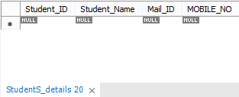
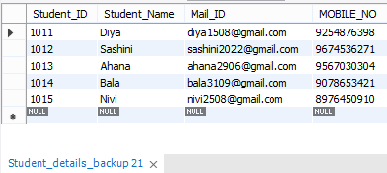
Similarly we are deleting the all other records from the main table “Students_Details” on mean time we are inserting those records into back up table “Student_details_backup”.
Students_Details Table output below:
Students_details_backup table output below:

Slide 22
References:
E-portfolio link
https://eportfolio.mygreatlearning.com/sujitha-l
https://eportfolio.mygreatlearning.com/pranit-jadhav
https://eportfolio.mygreatlearning.com/darshan-jayantbhai-bhatt
https://eportfolio.mygreatlearning.com/mohini-pujari
https://eportfolio.mygreatlearning.com/madabattula-jyothi

